Slide 1

Airline Delay Analysis and Prediction

Slide 2

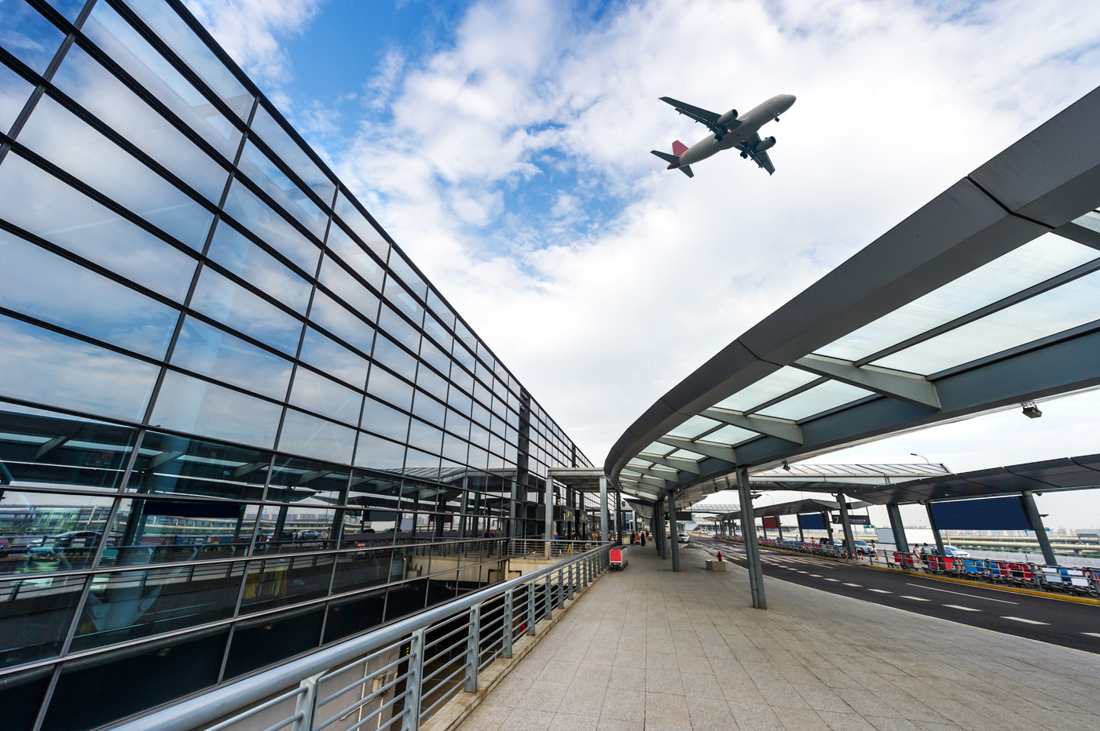

AIRLINES
FLIGHT
Introduction to the Problem
Airline delays impact the airline industry, leading to lower customer satisfaction, revenue loss, and negative publicity.
Analyzing delay data can help businesses identify patterns, root causes, and solutions, as well as optimize resource allocation and cost management
By identifying flight-prone delays, airlines can enhance efficiency, reduce costs, and adjust crew numbers, gate allocations, and fuel usage.
Overall, studying airline delays provides valuable insights for enhancing operational performance, customer experience, cost management, and safety.

Slide 3

AIRLINES
FLIGHT
Data Analysis
The Cross-Industry Standard Process for Data Mining (CRISP-DM) Model will be used as our dataset's analysis and prediction model. An effective and organised approach to a data mining project is provided by this methodology. CRISP-DM
Business Understanding
Data Understanding
Data Preparation
Modelling
Analysis
Predictions
Deployment

Slide 4

AIRLINES
FLIGHT
Factors Affecting Flight Delays
Carrier Delay
Weather Delay
NAS Delay
Security Delay
LateAircraft Delay

Slide 5
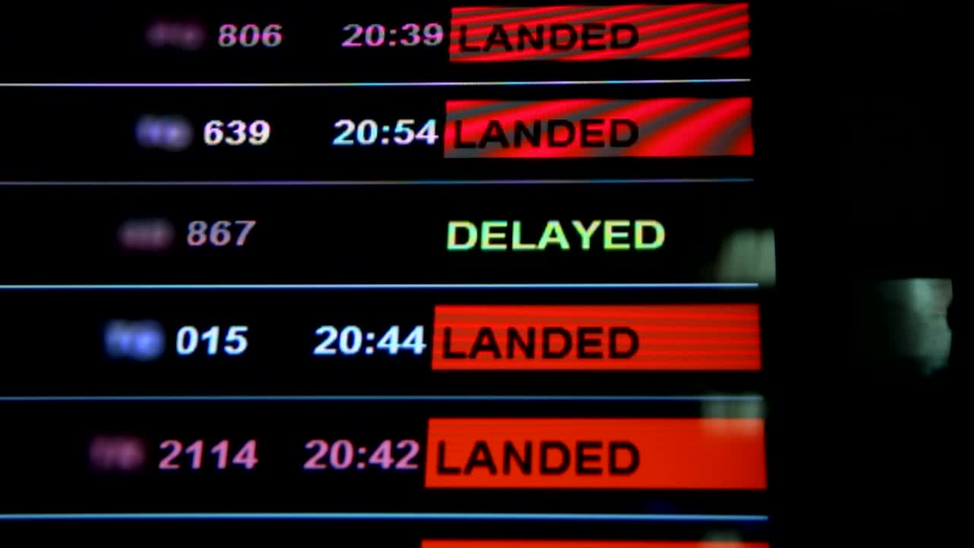
AIRLINES
FLIGHT
Delay Prediction
Based on the Departure Delay we are predicting Arrival Delay.
Random Forest
93%
Linear Regression
94.18%
XG Boost
93%
Decision Tree
87.02%

Slide 6

Key Learnings
Data preprocessing: Understanding the importance of cleaning, preprocessing, and transforming data to prepare it for analysis and modelling.
Feature selection: Identifying relevant features to predict arrival delays, which can impact model accuracy and performance.
Model evaluation: Comparing different machine learning models based on specific performance metrics (e.g., Mean Squared Error, R2 value) to select the most suitable model for the task.
Model interpretation: Gaining insights into the relationships between different factors, such as taxi-in/out times and flight cancellations, and their impact on flight delays.

Slide 7

AIRLINES
FLIGHT
Results and conclusions
There is a strong correlation between departure delay and arrival delay.
However, while departure delay can be a useful predictor of arrival delay, it should not be the sole factor considered when predicting or managing flight delays.
Therefore, it's important to note that there may be other factors that can also impact the arrival time, such as weather conditions, air traffic congestion, and maintenance issues.

Slide 8

AIRLINES
FLIGHT
Thank You For All Your Time & Attention
Search Destination
End Slide

